Slide 1

Python for the Real world: a hackathon Crash course
Part (1/2) - Foundation

Slide 2
Who Am I, What am I here for
Mike Presman
Student & developer
Aspiring swe
Teach foundations of python
Teach you backend flask development (part 2)
2-3 years of Python experience
2 Years Flask backend Experience
Python fanboy

Slide 3
Contact
https://github.com/mikepresman
https://www.linkedin.com/in/198593021/
mikepresman@gmail.com

Slide 4
Goals of This Course
Lay a foundation for Python Development
Get you ready for part 2 of this series (Flask backend development)
Get you Hackathon ready

Slide 5
What this Workshop Isnt
Will not teach you fundamental programming
Expressions, Statements, Paradigms etc.
Goal of this workshop is to teach you Python. Hopefully you have an understanding of basics and or have completed EECS1012 or equivalent
This workshop may seem elementary but please note that basic python is a required foundation for backend flask development.
Gotta learn what a theorem is before we learn how to prove one ☺

Slide 6
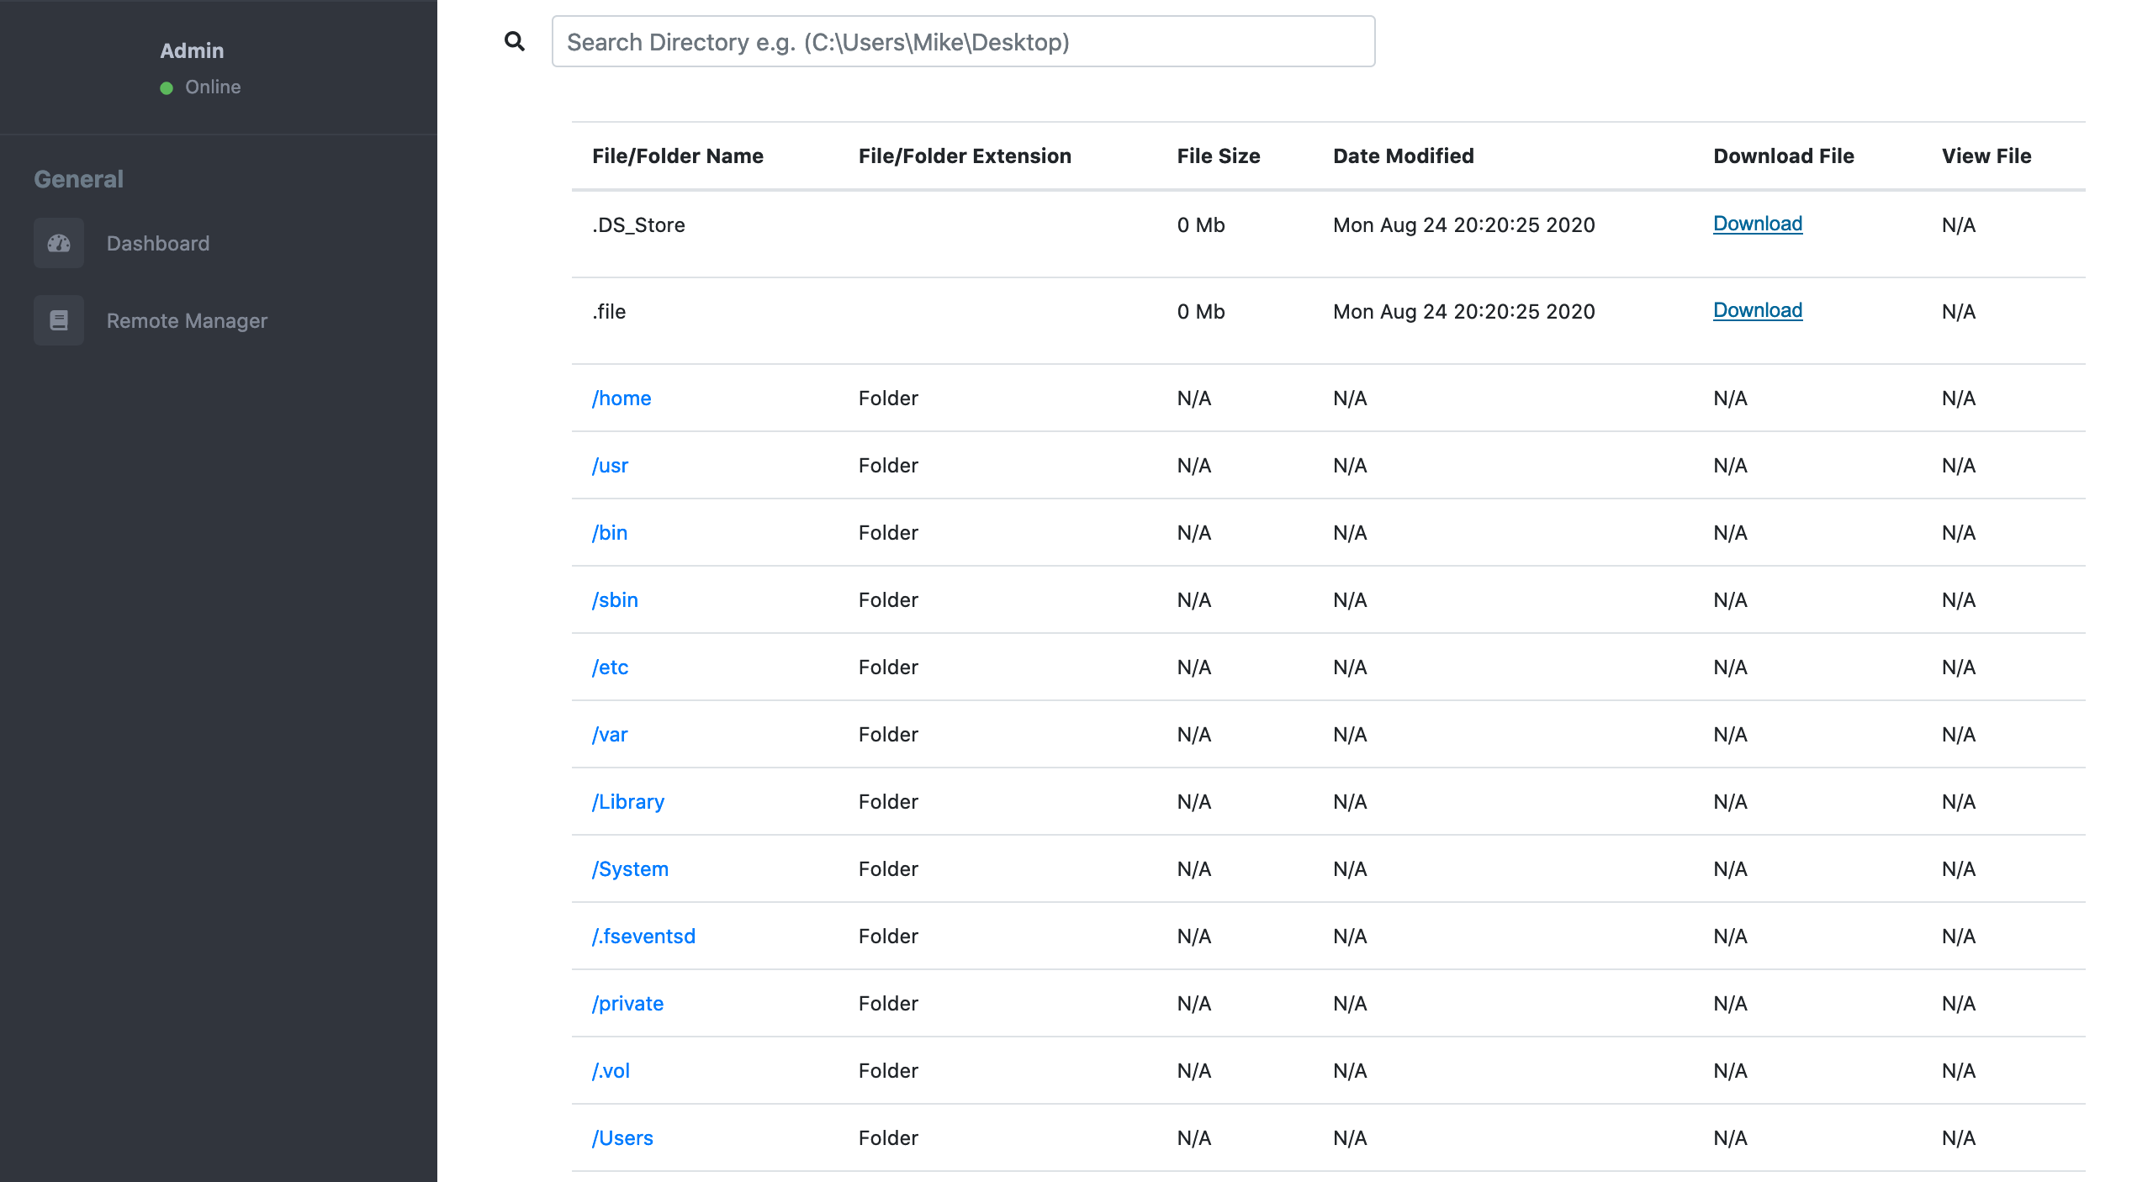
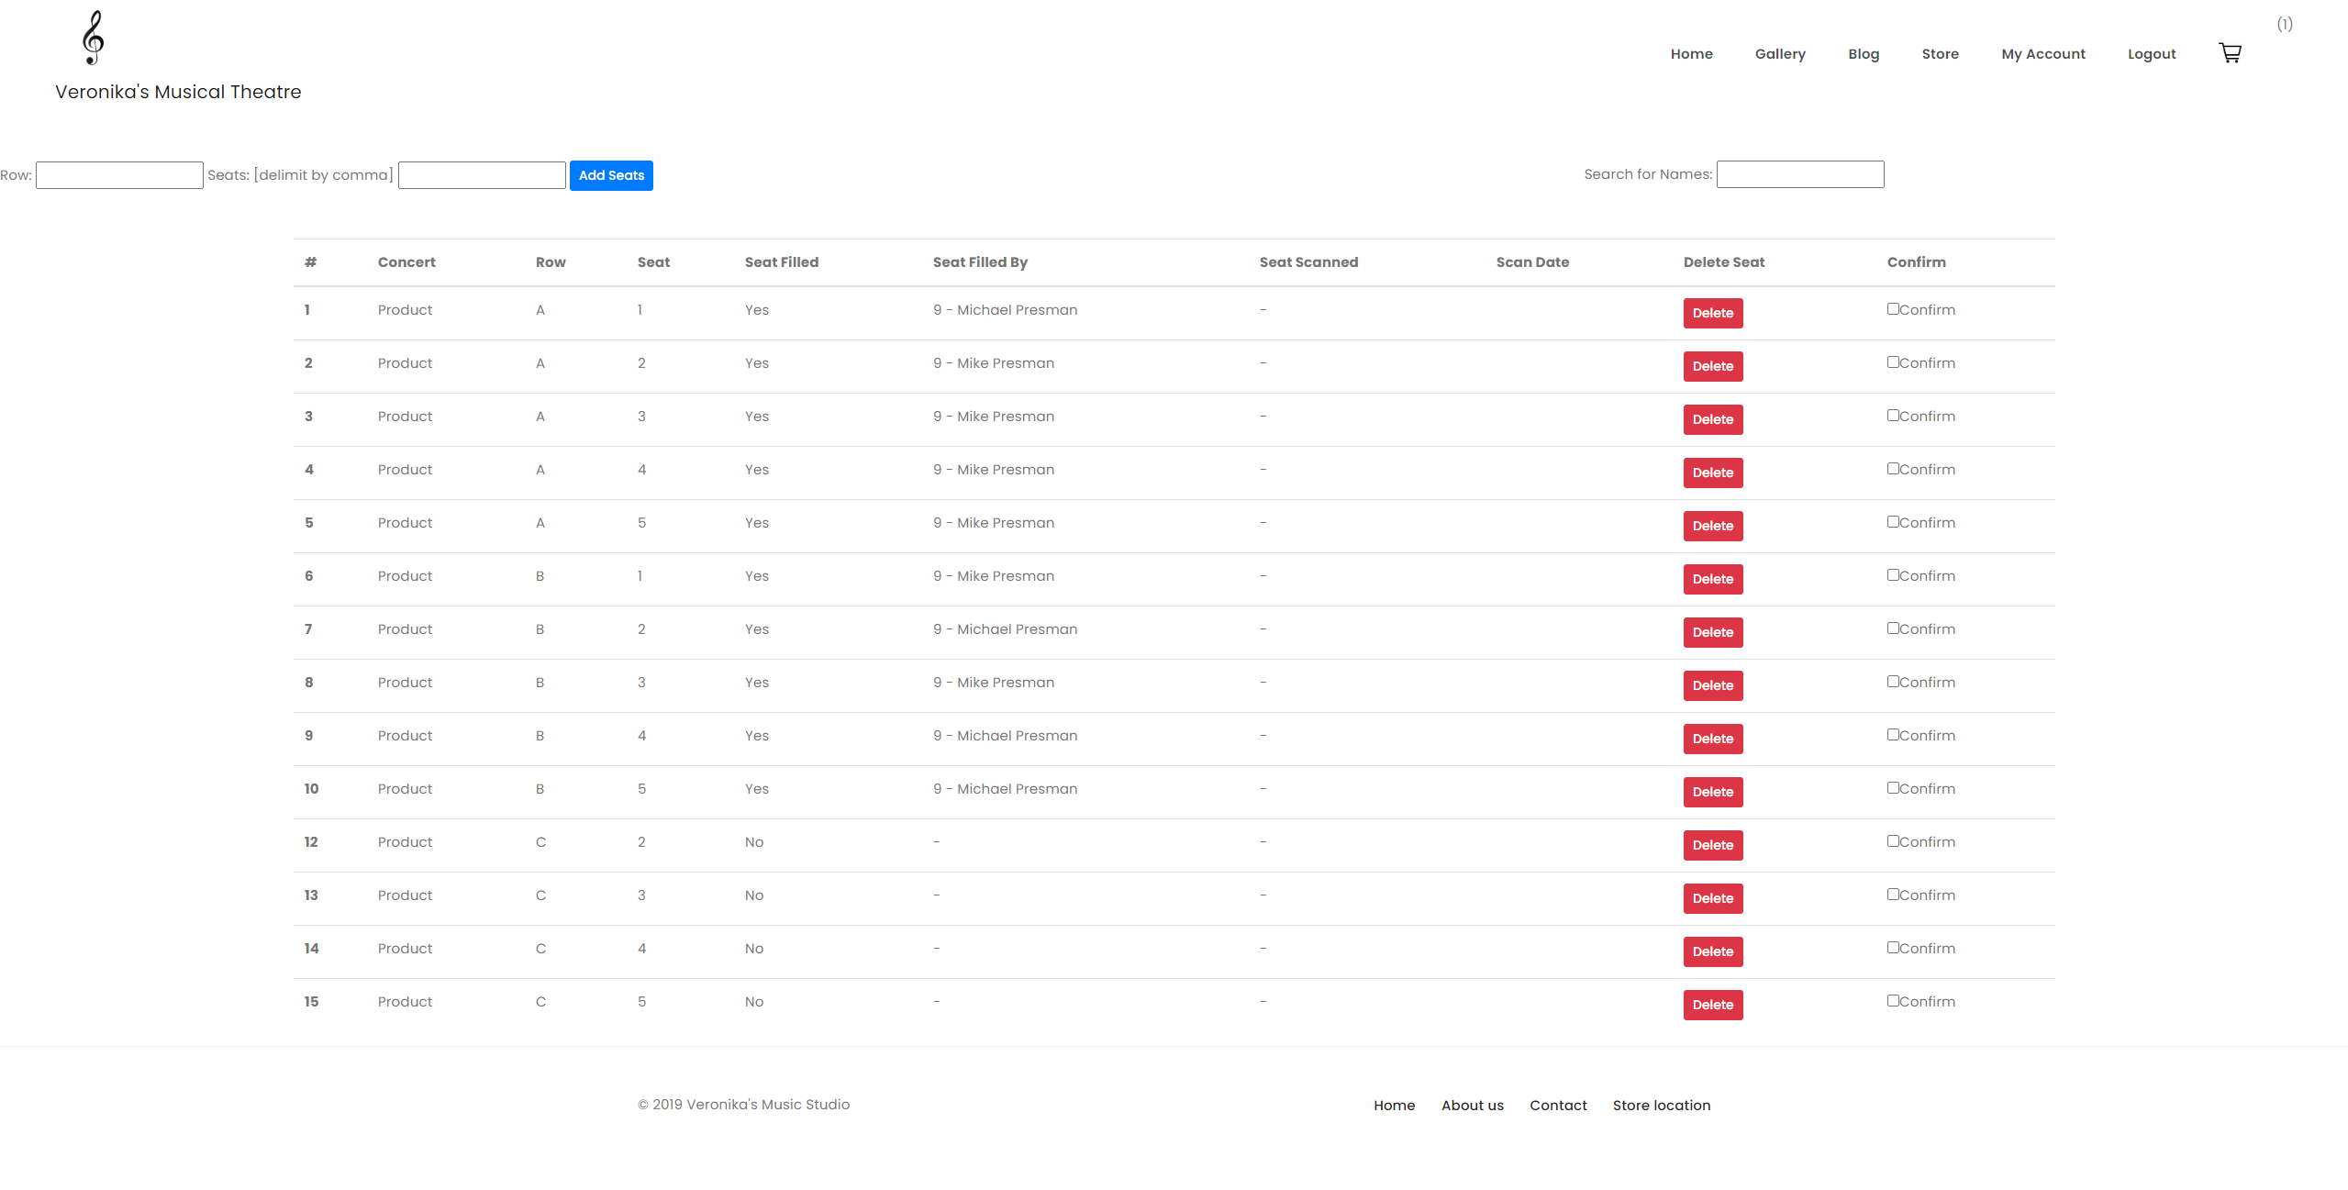
Examples of Potential End-product

Slide 7
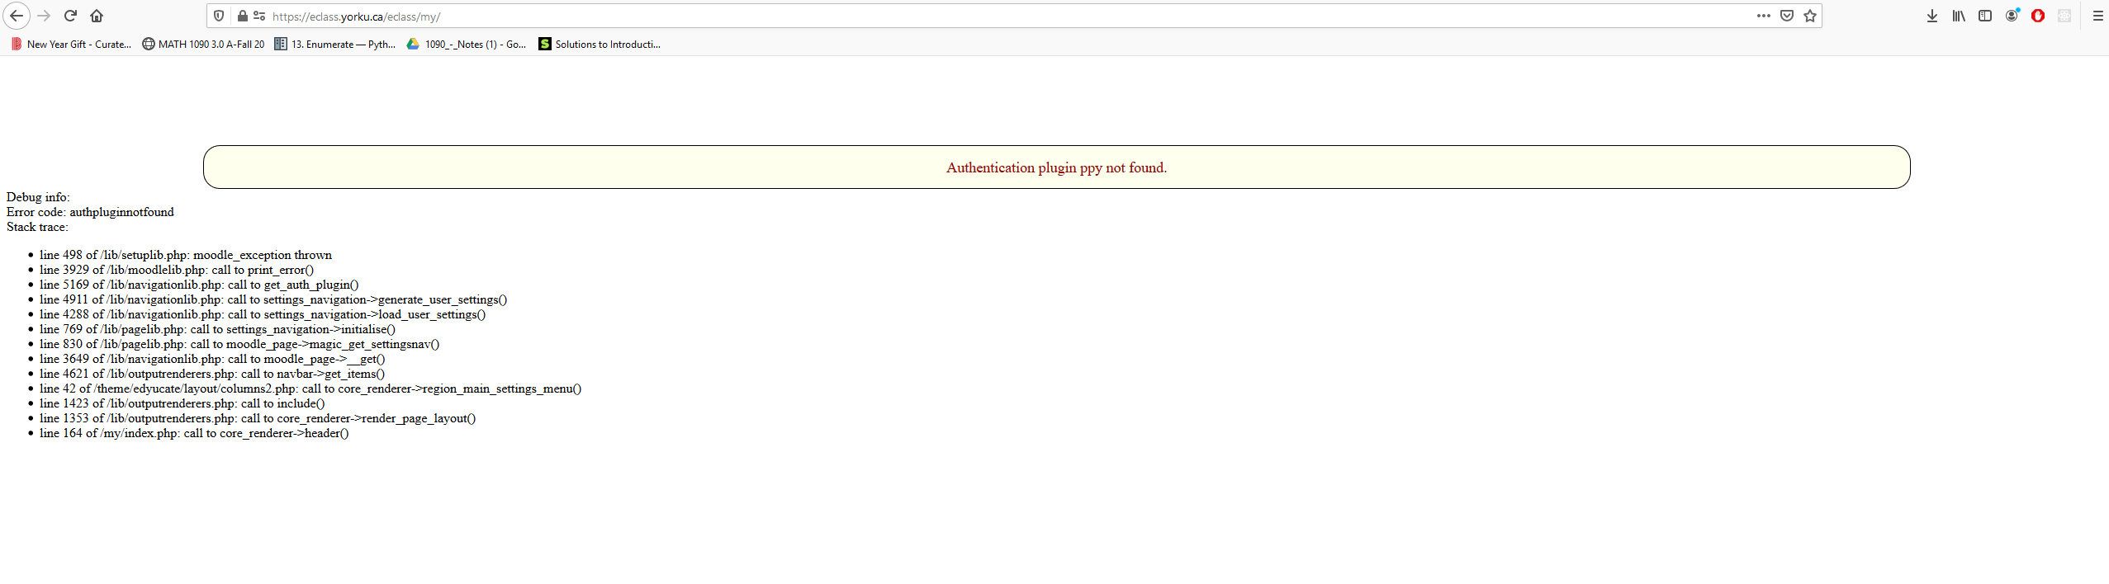
What we Don’t want to end up with

Slide 8
Setting Up (Hard(er) Way)
We Need Python3+
Pip Package Manager, What is a Package Manager (We will use it heavily in part 2)
A virtualenviornment (venv or virtualenv) – Why we use it (Separation of libraries)
Windows & Mac: First Screen Add Python to PATH, checkmark it then do basic installation (not manual)
Windows : https://www.python.org/ftp/python/3.8.5/python-3.8.5.exe
Ubuntu/Debian Distros: sudo apt install python3.8
(MAYBE; DON’T RUN YET) sudo apt-get install python3.8-venv
Mac OSX: https://www.python.org/downloads/mac-osx/
Should all come with Pip
Texteditor (I recommend VSC)

Slide 9
Setting up Virtualenv
A little tricky because Windows handles things differently than Unix (Mac and Linux)
For Windows on your own time search up WSL to get a Linux emulated terminal – not now ☺
Anything with $ and brackets is a command, do not type the dollar sign or brackets
On Windows, Mac and Linux, Open Terminal
Windows, windows key + r, type $‘cmd’, hit enter
Mac, command + space bar, type in terminal and hit enter
Linux – well you already should know
Mac and Linux cd where you want to, if you don’t know then type in $‘cd ~/’ in your terminal
Check we have python, $‘python3.8 --version’ >> Python3.8.x
$`mkdir my_venv`
$`cd venv`
$`python3.8 –m venv ./`
$`source bin/activate` >> should now have (venv) in front ☺
Problem with Ubuntu? run $`sudo apt-get install python3.8-venv` and try again
Windows
$’cd desktop`
$`python --version` >> (double dashes -- )
$’mkdir my_venv`
$`cd venv`
$`python3.8 –m venv ./`
$`cd Scripts && activate` >> (venv)

Slide 10
Aside
Funny enough windows and mac was the easiest. But Ubuntu worked fine after one small fix.
Struggled? So did I when I first began
Didn’t work? No Problem. Not strongly needed to have it installed can still follow along without missing anything and setup later !

Slide 11
Alternative – Easi(er) Way
https://www.programiz.com/python-programming/online-compiler/

Slide 12
Python Overview
When to use Python ? When not Use it?
Weakly Typed
Procedural, OOP, and Functional Support
Easy to Pickup
Multiplatform (Unix and Windows)
Why use Python at a Hackathon

Slide 13
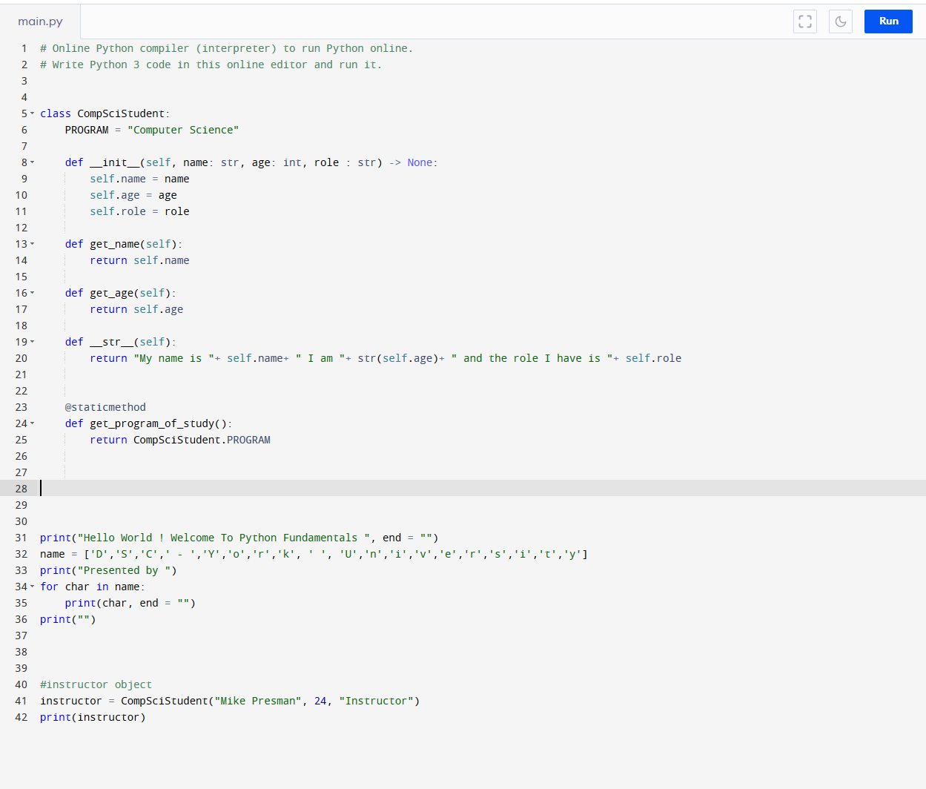
Flow of a Python program

Slide 14
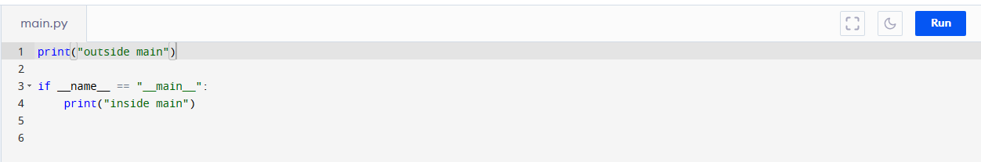
Alternative flow – Notice scope

Slide 15
Types and Useful Methods

Slide 16
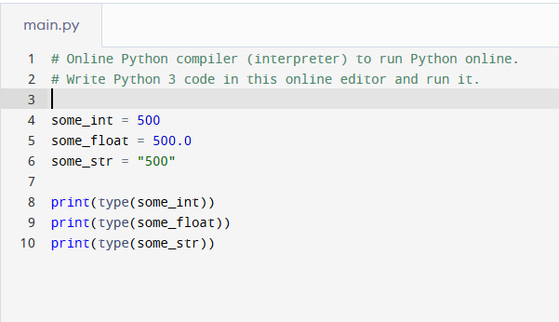
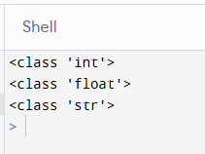
int, float, str
Initalizing an int, float and str respectively. (Loosely typed)
some_int = 500
some_float = 500.0
some_str = “500” (or ‘500’ with single brackets)
First ! How do you figure out type? – The type keyword

Slide 17
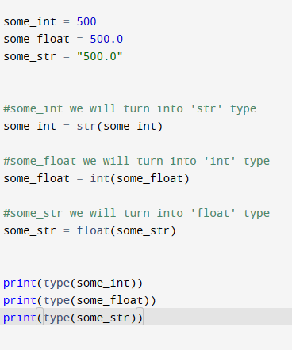
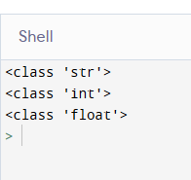
Parsing One Type to Another

Slide 18
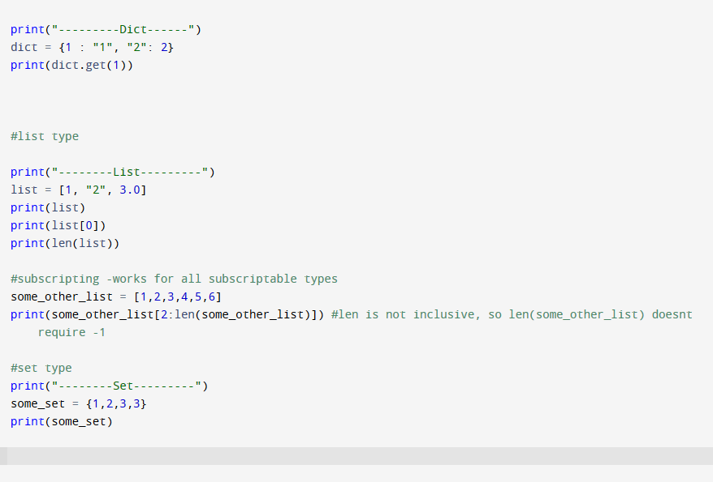
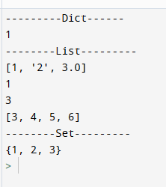
Dictionaries, Lists, and Sets
Dictionary – Similar to Java HashMap<T> type
Lists – similar to array type in Java
Sets – an unordered, unindexable array, that contains unique elements

Slide 19



Iterating a Dictionary
V1
Another Way- Get a Tuple that is unpacked on call

Slide 20
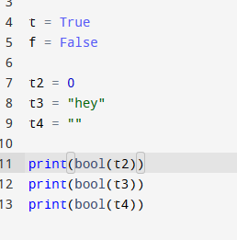
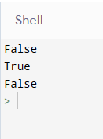
Boolean
Some unique behaviour that you might not expect…

Slide 21
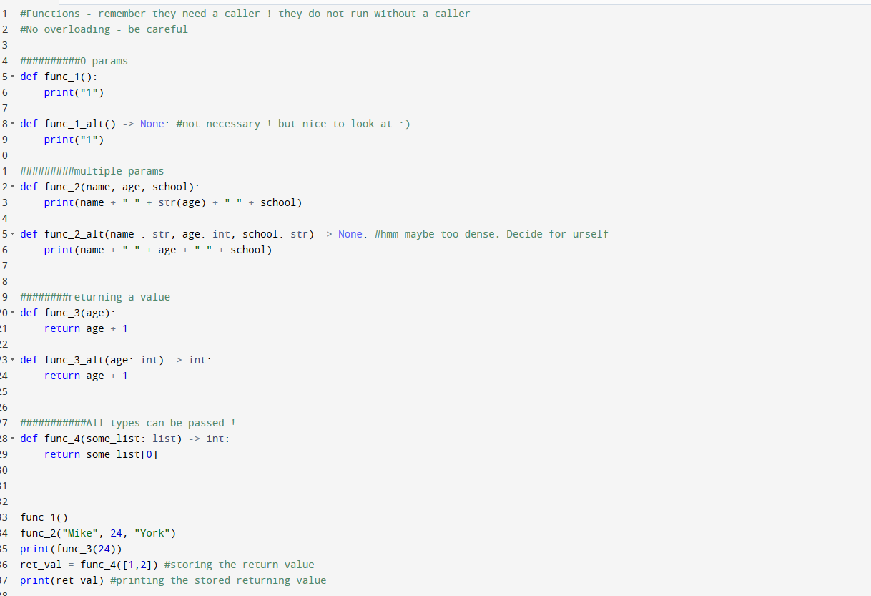
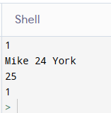
Functions

Slide 22
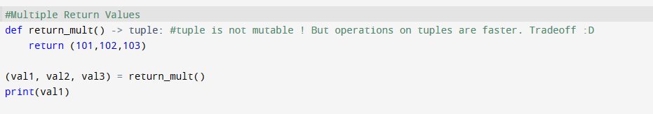

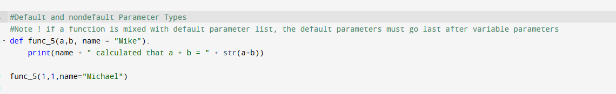

Functions - 2

Slide 23
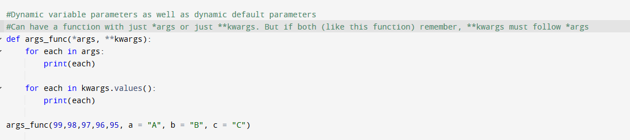
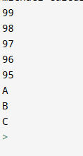
Functions – 3

Slide 24
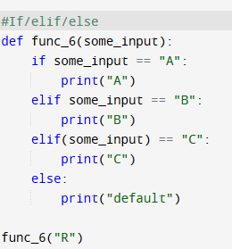
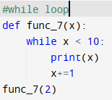
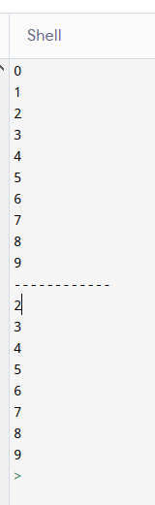
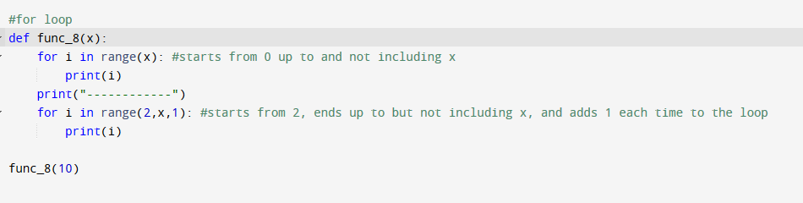
Loops, and Statements

Slide 25
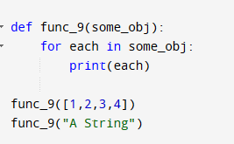
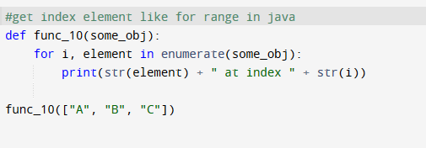

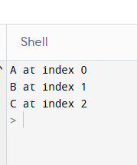
Loops and Statements Continued

Slide 26

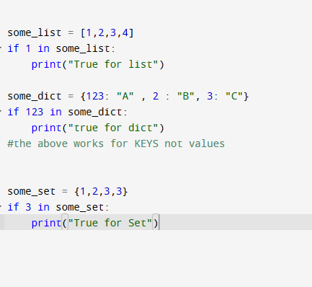
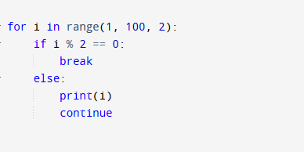

‘In’ Keyword, Pass, Continue, Break

Slide 27
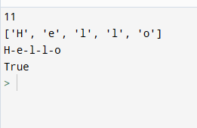
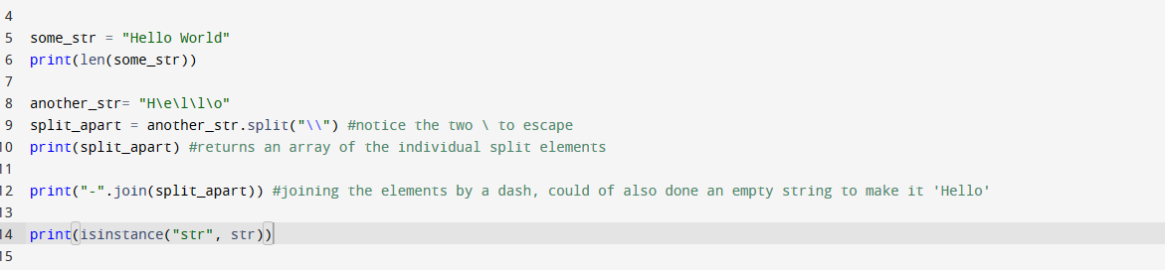
Good to Know Methods
I don’t like discussing specific object methods because there are so many, but these are unavoidable and good to know they exist.
Pro Tip: Don’t remember how to use something forcibly, learn that it exists so you can google it after
This is why Stackoverflow exists :D

Slide 28
Pass by Object Reference
Huh ?
This understanding requires knowledge on how python handles objects and variable binding
Beyond the scope of this workshop
We will just say Pass by Value. Good enough and consistent with what you know, Like Java

Slide 29
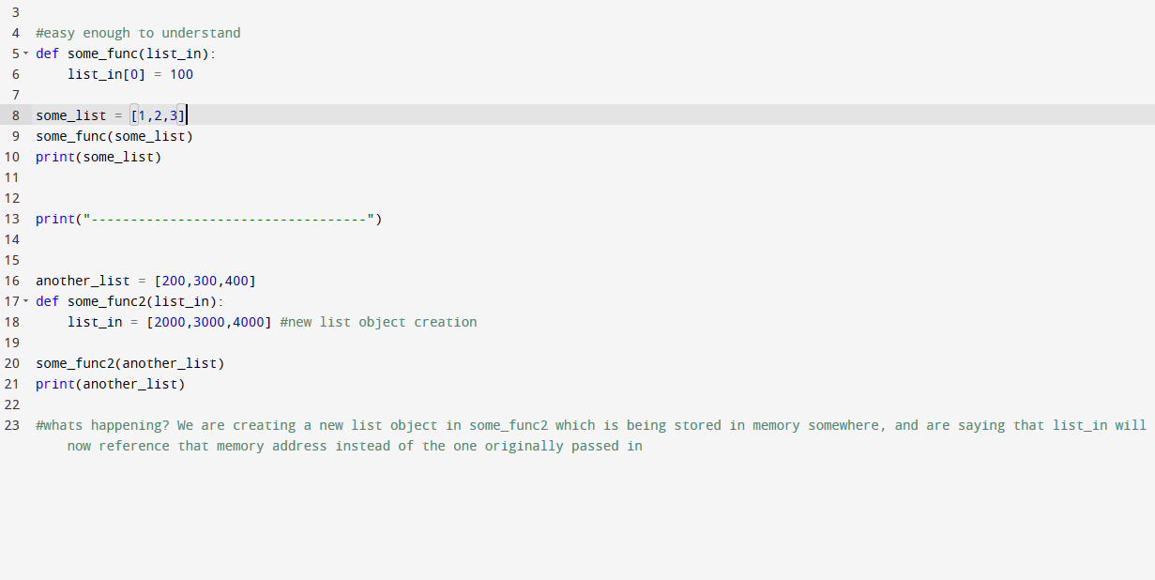
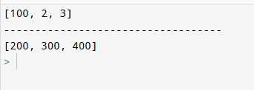

Slide 30
More Advanced Topics

Slide 31
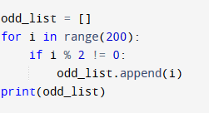

List Comprehension
VS.

Slide 32
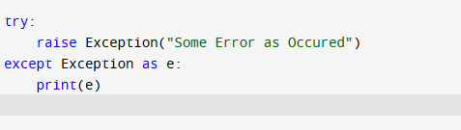
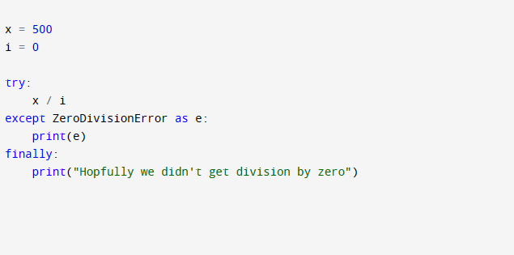
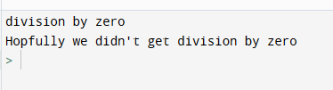

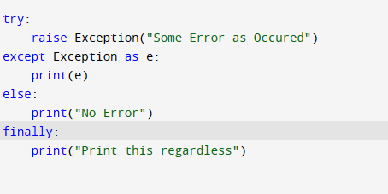
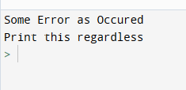
Error Handling

Slide 33
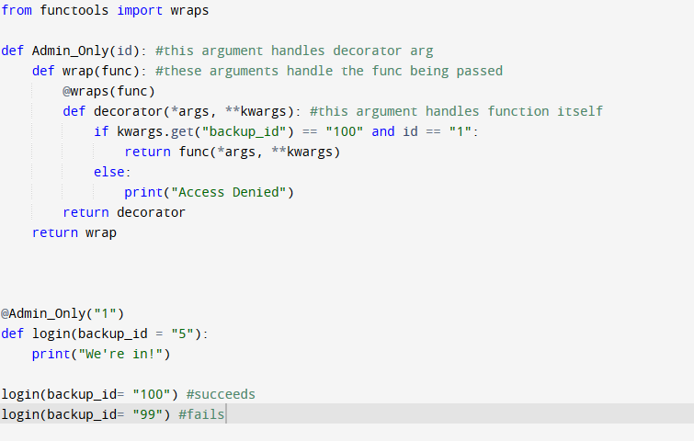

Decorators

Slide 34
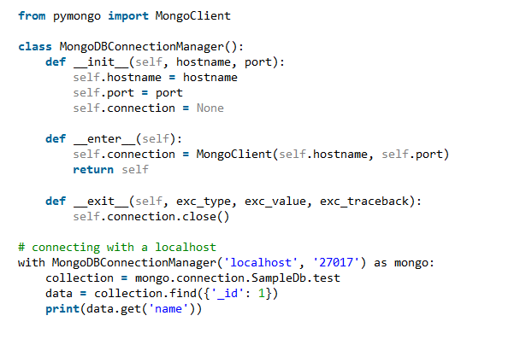
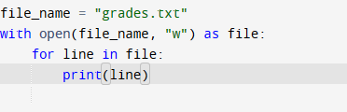
Context Managers
File gets closed automatically out of the scope thanks to context manager of open()

Slide 35
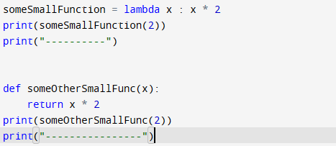

Lambda Functions

Slide 36
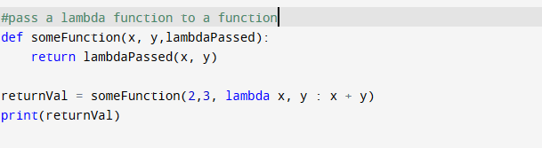
Lambda Continued

Slide 37
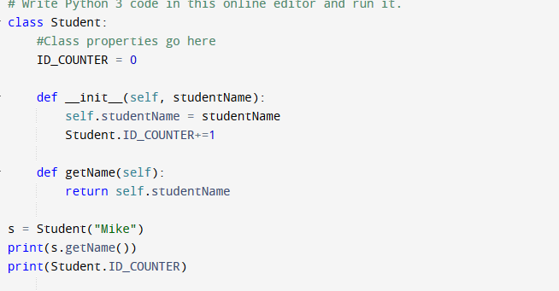

Classes

Slide 38
Topics We Will Discuss next TIme
Imports
Project Structure
In Depth Classes
Coming Together
Flask of course

Slide 39
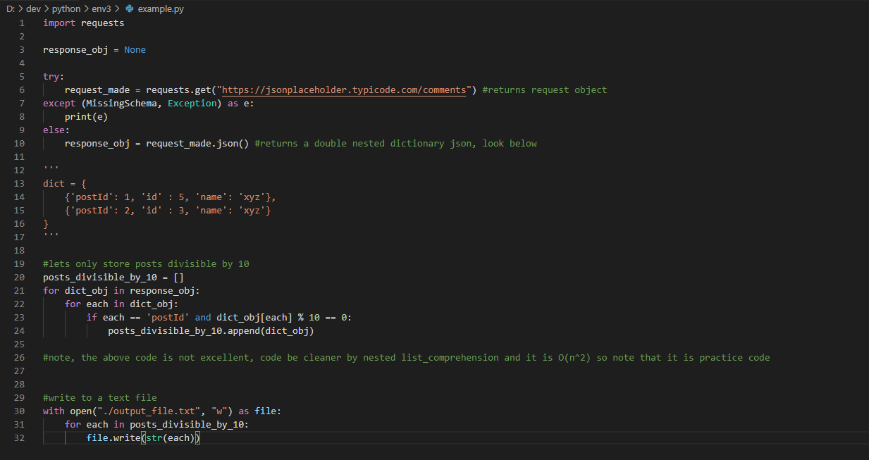
Example Project. Compare this to the amount of lines it would take in Java

Slide 40
Additional Resources
https://automatetheboringstuff.com/
https://blog.miguelgrinberg.com/post/the-flask-mega-tutorial-part-i-hello-world
https://docs.python.org/3/
https://pypi.org/

Slide 41
Thank you !

